Slide 1
data
posterior
learning
prior
model
applications
trial
design
actions

Slide 2
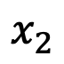
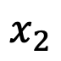
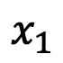
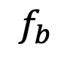
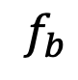

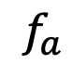
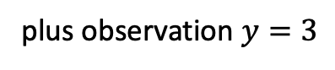
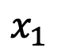
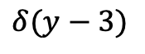
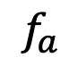
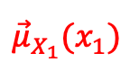
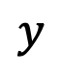
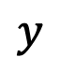
$${\vec{μ}}_{X_{1}}(x_{1})$$
$$f_{a}$$
$$x_{1}$$
$$x_{1}$$
$$x_{2}$$
$$x_{1}$$
$$x_{2}$$
$$f_{a}$$
$$f_{b}$$
$$f_{a}$$
$$f_{b}$$
$$≡$$
$$y$$
$$y$$
plus observation $y=3$
$$δ(y−3)$$

Slide 3
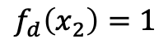
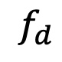
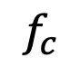
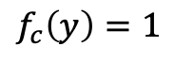
$${\vec{μ}}_{X_{1}}(x_{1})$$
$$f_{a}$$
$$x_{1}$$
$$x_{1}$$
$$x_{2}$$
$$x_{1}$$
$$x_{2}$$
$$f_{a}$$
$$f_{b}$$
$$f_{a}$$
$$f_{b}$$
$$f_{d}$$
$$≡$$
$$f_{d}\left(x_{2}\right)=1$$
$$y$$
$$y$$
$$f_{c}$$
$$f_{c}\left(y\right)=1$$

Slide 4
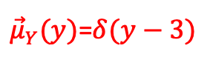
$${\vec{μ}}_{X_{1}}(x_{1})$$
$$f_{a}$$
$$x_{1}$$
$$x_{1}$$
$$x_{2}$$
$$x_{1}$$
$$x_{2}$$
$$f_{a}$$
$$f_{b}$$
$$f_{a}$$
$$f_{b}$$
$$≡$$
$$y$$
$$y$$
${\vec{μ}}_{Y}(y)$=$δ(y−3)$
plus observation $y=3$
$$δ(y−3)$$

Slide 5
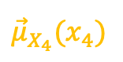
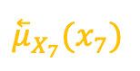
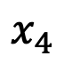
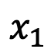

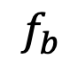
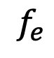
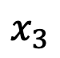
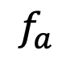
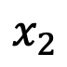
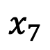
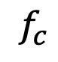
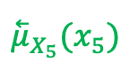
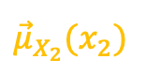
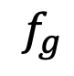
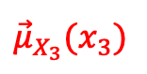
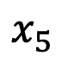
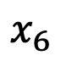
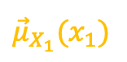
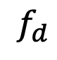
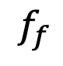
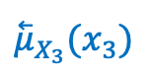
$$f_{b}$$
$$f_{d}$$
$${\vec{μ}}_{X_{2}}(x_{2})$$
$${\vec{μ}}_{X_{4}}(x_{4})$$
$$x_{2}$$
$$x_{4}$$
$${\overset{⃖}{μ}}_{X_{3}}(x_{3})$$
$${\overset{⃖}{μ}}_{X_{5}}(x_{5})$$
$$1$$
$${\vec{μ}}_{X_{1}}(x_{1})$$
$$x_{3}$$
$$f_{a}$$
$$f_{c}$$
$$f_{e}$$
$$f_{f}$$
$$x_{1}$$
$$x_{5}$$
$$x_{6}$$
$${\vec{μ}}_{X_{3}}(x_{3})$$
$$x_{7}$$
$${\overset{⃖}{μ}}_{X_{7}}(x_{7})$$
$$f_{g}$$

Slide 6
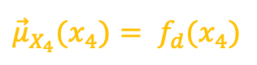
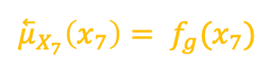


$$f_{b}$$
$$f_{d}$$
$${\vec{μ}}_{X_{2}}(x_{2})$$
$${\vec{μ}}_{X_{4}}(x_{4})= f_{d}(x_{4})$$
$$x_{2}$$
$$x_{4}$$
$${\overset{⃖}{μ}}_{X_{3}}(x_{3})$$
$${\overset{⃖}{μ}}_{X_{5}}(x_{5})$$
$${\vec{μ}}_{X_{1}}(x_{1})$$
$$1$$
$$x_{3}$$
$$f_{a}$$
$$f_{c}$$
$$f_{e}$$
$$f_{f}$$
$$1$$
$$x_{1}$$
$$x_{5}$$
$$x_{6}$$
$${\vec{μ}}_{X_{3}}(x_{3})$$
$$x_{7}$$
$${\overset{⃖}{μ}}_{X_{7}}\left(x_{7}\right)= f_{g}(x_{7})$$
$$f_{g}$$

Slide 7
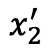
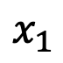
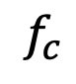
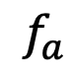
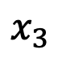

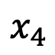
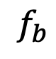
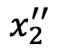
$$x_{2}^{′′}$$
$$f_{a}$$
$$=$$
$$f_{c}$$
$$x_{1}$$
$$x_{2}$$
$$x_{4}$$
$$x_{2}^{′}$$
$$f_{b}$$
$$x_{3}$$

Slide 8
Machine learning
Trial design /
Decision-making
supervised learning
unsupervised learning
Other stuff
Reinforcement
learning
classification
regression
clustering
compression
Active inference

Slide 9
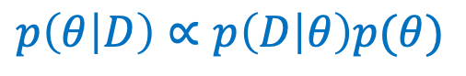



data
learning
posterior
$$p\left(D | θ\right)$$
$$p\left(θ | D\right)∝p\left(D | θ\right)p(θ)$$
prior
model
applications
$$p(θ)$$
$$p\left(x | D\right)∝\sum_{θ}{p\left(x | θ\right)}p(θ|D)$$
trial
design
(for prediction)
actions

Slide 10




actions
$$a$$
agent
$$R$$
$$p(x,s,u)$$
observations
$$x$$

Slide 11





data
learning
posterior
$$p\left(D | θ\right)$$
$$q\left(θ | D\right)∝p\left(D | θ\right)p(θ)$$
prior
model
applications
$$p(θ)$$
$$p\left(x | D\right)∝\sum_{θ}{p\left(x | θ\right)}p(θ|D)$$
trial
design
(for prediction)
q$\left(u\right)∝exp⁡(−G(u))$
actions

Slide 12
machine learning
data
posterior
learning
prior
model
applications
e.g., algorithms for
classification, regression, prediction, etc.
trial
design
actions
scientific inquiry loop
engineering

Slide 13
data
posterior
learning
prior
model
trial
design
actions
agent

Slide 14
observations
sensors
model
goals
prior on
future
observations
actuators
actions
agent

Slide 15
“sensory” data
machine
learning
posterior
goals
prior
model
prior on
future
sensations
trial
design
actions
agent

Slide 16
General framework
Specific example
“sensory” data
data
posterior
machine
learning
posterior
learning
“reward” data
prior
prior
model
model
trial
design
trial
design
actions
actions
agent
agent

Slide 17
compressed
(encoded)
original
decoded

